Slide 1
Social Media Analytics
By Pooja Kasar

Slide 2
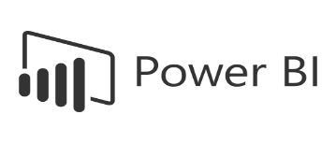



Project Summary
Objective: Analyze multi‑platform like Facebook, Google & LinkedIn social media performance using dashboards.
  Improve decision-making using KPIs and trend analysis.
  Build dashboards in Excel, Tableau, and Power BI.
  Deliver actionable insights for marketing optimization.
Tools Used:

Slide 3
KPI List – Business Relevance (Facebook, Google, LinkedIn)
1. Facebook Dataset – KPIs & Business Relevance
• Impressions – Measures ad visibility and audience reach.
• Link Clicks – Indicates engagement and traffic generated.
• Cost – Total amount spent on Facebook ads.
• Cost Per Click (CPC) – Shows efficiency of spending (Cost / Clicks).
• Click-Through Rate (CTR%) – Measures effectiveness of creatives (Clicks / Impressions).
• Age-wise Link Clicks – Helps identify best-performing age segments.
• Campaign-wise Cost – Used for budget allocation and optimization.

Slide 4
KPI List – Business Relevance (Facebook, Google, LinkedIn)
2. Google Ads Dataset – KPIs & Business Relevance
• Total Impressions – Displays how often Google ads were shown.
• Total Clicks – Measures user engagement and interest.
• Total Cost – Tracks total Google ad spend.
• Conversions – Represents user actions (sales, leads, etc.).
• CTR% – Indicates how often impressions become clicks.
• CPC – Monitors cost efficiency for each click.
• Campaign-wise Spend – Shows top-performing and high-budget campaigns.
• Ad Group Click Distribution – Identifies best-performing ad groups.

Slide 5
KPI List – Business Relevance (Facebook, Google, LinkedIn)
3. LinkedIn Dataset – KPIs & Business Relevance
• Total Comments – Measures audience engagement through discussions.
• Total Followers – Indicates audience size and brand authority.
• Total Views – Shows post visibility and reach.
• Total Reactions – Measures user response to content.
• Total Reposts – Indicates content shareability and organic reach.
• Engagement Rate – Shows overall effectiveness of posts.
• Followers by Topic – Helps understand audience interests.
• Day/Month-wise Views – Helps optimize posting schedule.

Slide 6
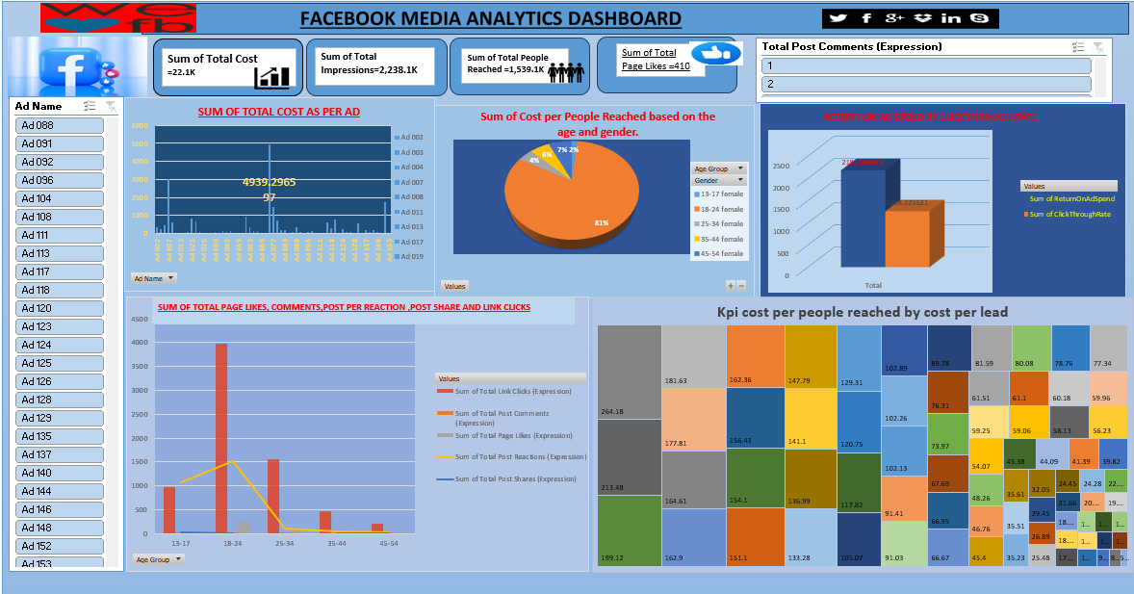
Excel Dashboard

Slide 7
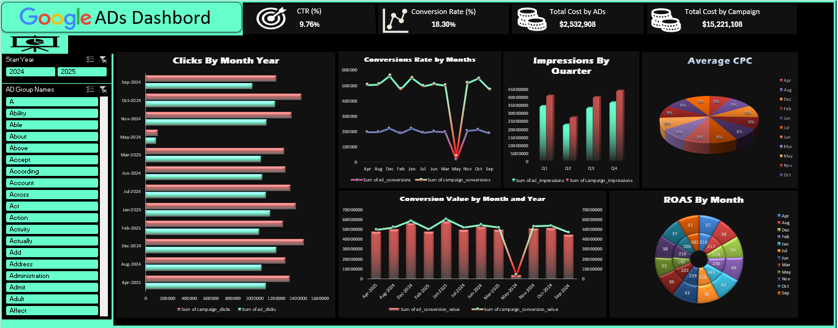
Excel Dashboard

Slide 8
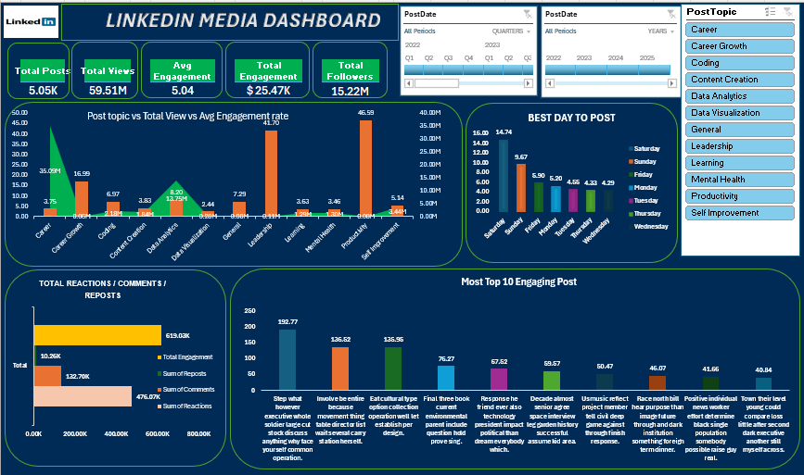
Excel Dashboard

Slide 9
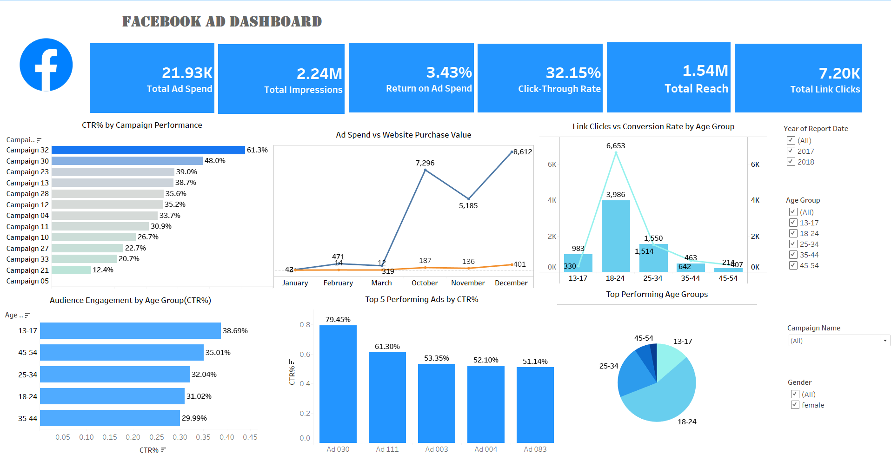
Tableau Dashboard

Slide 10
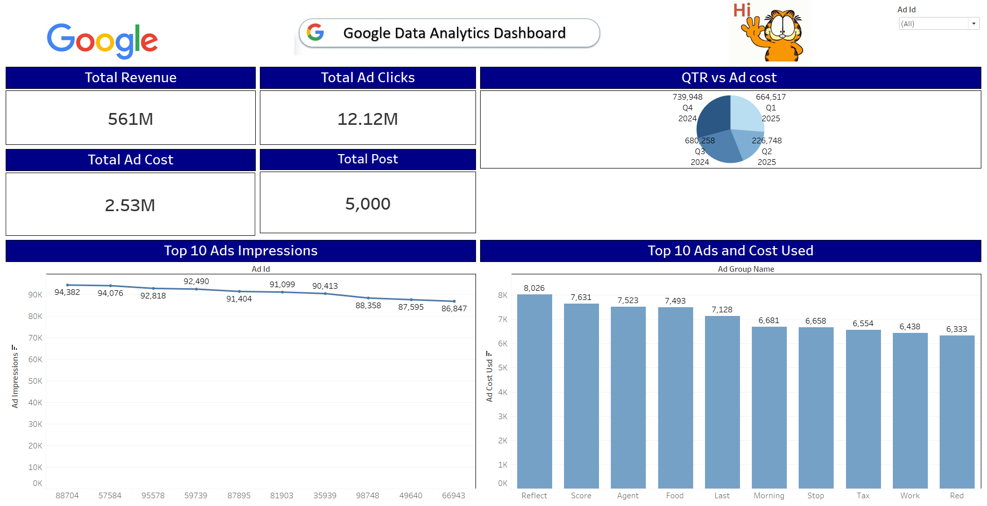
Tableau Dashboard

Slide 11
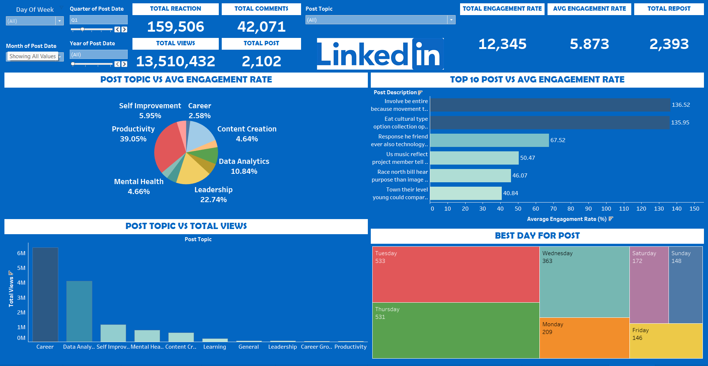
Tableau Dashboard

Slide 12
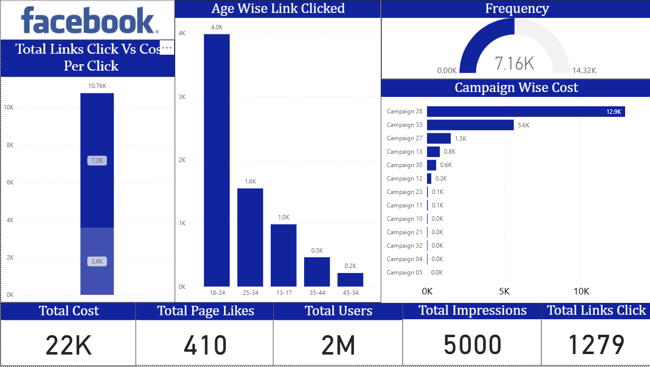
Power BI Dashboard

Slide 13
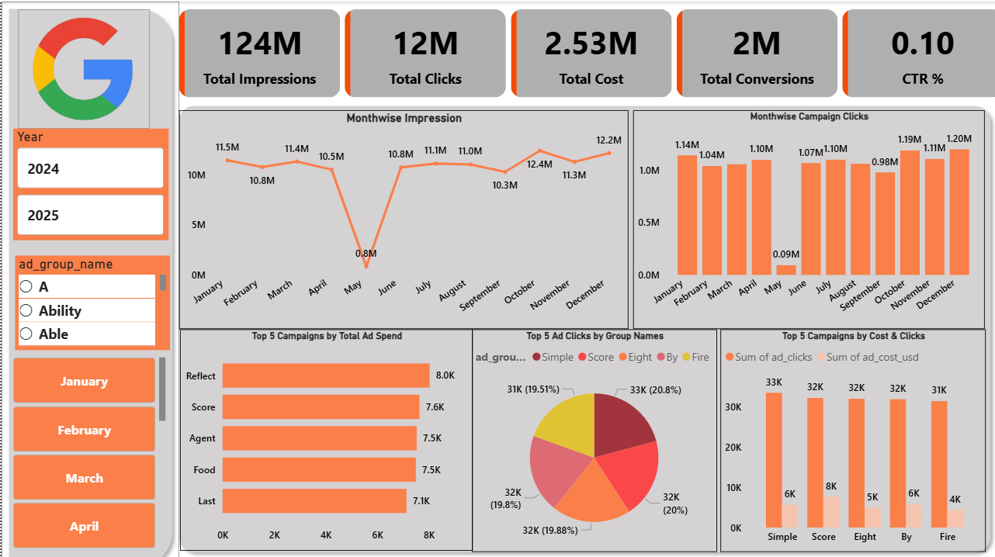
Power BI Dashboard

Slide 14
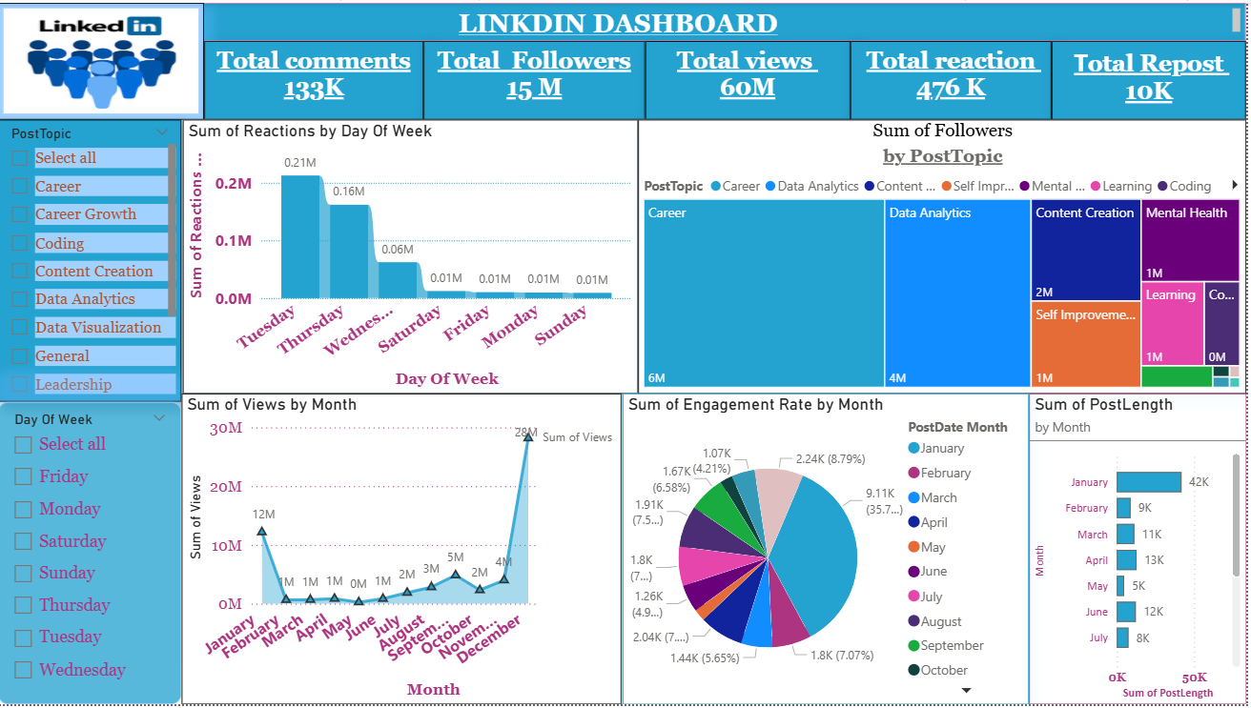
Power BI Dashboard

Slide 15
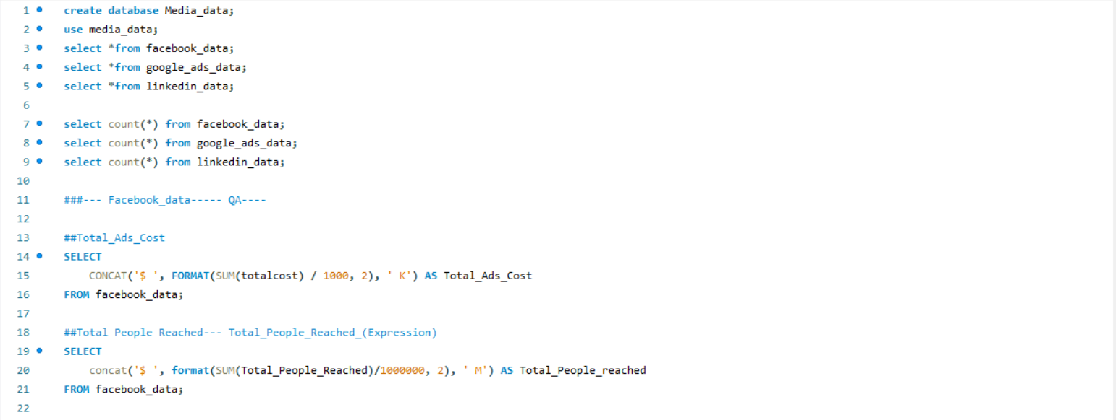
SQL Query Image

Slide 16
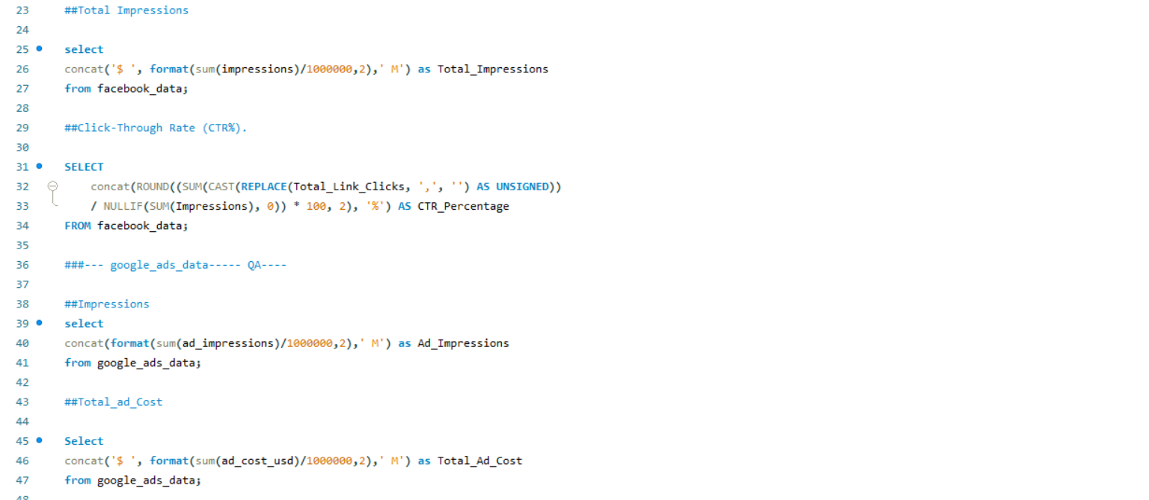
SQL Query Image

Slide 17
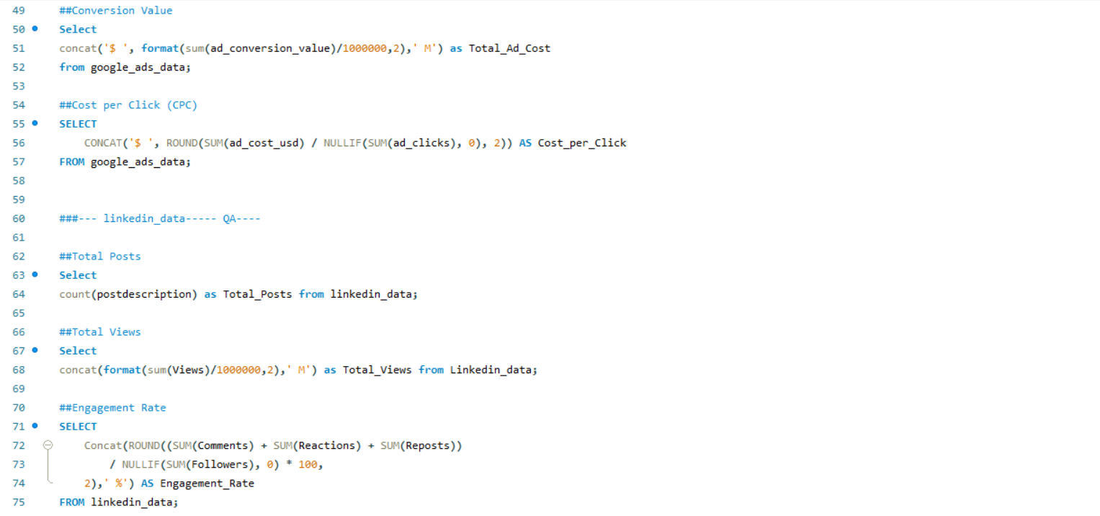
SQL Query Image

Slide 18
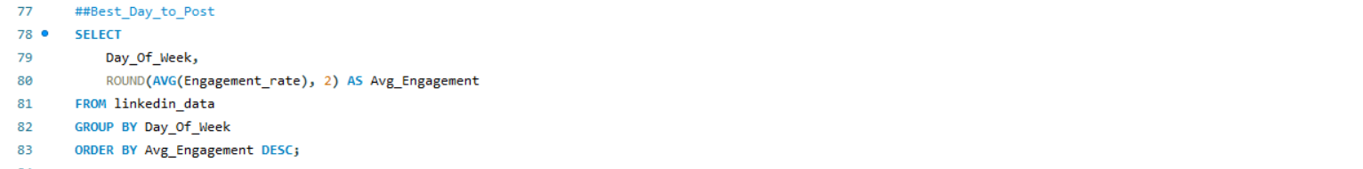
SQL Query Image

Slide 19
Key Takeaways
Facebook Analytics – Key Takeaways
• The highest link clicks came from the 18–24 and 25–34 age groups, showing strong engagement among younger audiences.
• Campaign 28 consumed a significant portion of the overall budget, indicating potential overspending or high competitive bidding.
• CTR remains moderate, suggesting creatives could be optimized for better user response.
• Impressions and clicks show seasonal variation, highlighting the importance of timing in campaign planning.
2. Google Ads Analytics – Key Takeaways
• Total impressions and clicks remain consistent across months, except for a notable dip in May.
• Top-performing ad groups contribute more than 60% of total clicks, showing strong keyword/audience alignment.
• Cost per ad group shows moderate variation, suggesting stable bidding strategy overall.
• Conversion volume remains strong, indicating effective campaign structure.
3. LinkedIn Analytics – Key Takeaways
• Career and Data Analytics topics generated the highest follower growth, showing strong audience interest.
• Views peak in January and December, suggesting seasonal audience engagement patterns.
• Reactions and comments were highest on professional development content, indicating preference for upskilling themes.
• Engagement rate shows variation by month, with spikes tied to trending or motivational posts.

Slide 20
Future Recommendations
Future Recommendations – Facebook
• Reallocate budget from underperforming campaigns to high-performing segments like ages 18–34.
• Increase A/B testing for creatives to improve CTR and reduce CPC.
• Review Campaign 28 spend efficiency to ensure it aligns with ROI expectations.
• Use frequency capping to reduce ad fatigue, especially in long-running campaigns.
Future Recommendations – Google Ads
• Investigate the drop in impressions and clicks in May to avoid future performance gaps.
• Expand high-performing ad groups and pause low performers to improve ROI.
• Increase use of responsive search ads to optimize ad strength and relevance.
• Enhance conversion tracking to better understand campaign contributions.
Future Recommendations – LinkedIn
• Focus more on Career, Data Analytics, and Content Creation topics for maximizing engagement.
• Publish content more frequently during high-view months like January and December.
• Use carousels and storytelling posts to boost reactions and shares.
• Improve posting schedule by analyzing day-of-week engagement patterns.

Slide 21
Thank You😊

